Slide 1
SSW2023 Group Project:
Fitting Models to Data

Slide 2
Project Statement:
We aim to use grid fitting tools to analyze reduced spectra from different instruments for the exoplanet WASP-39b. The goal is to determine the best fit cloud-free parameters (M/H, C/O, internal heat, heat redistribution) and cloudy parameter (M/H, C/O, Internal Heat, Heat redistribution, log kzz ) for each of the following reduced spectrums :
NIRISS SOSS spectrum (Feinstein et al. 2023)
NIRSpec G395H spectrum (Alderson et al. 2023)
NIRSpec Prism spectrum (Rustamkulov et al. 2023)
NIRCam f322w2 spectrum (Ahrer et al. 2023)

Slide 3
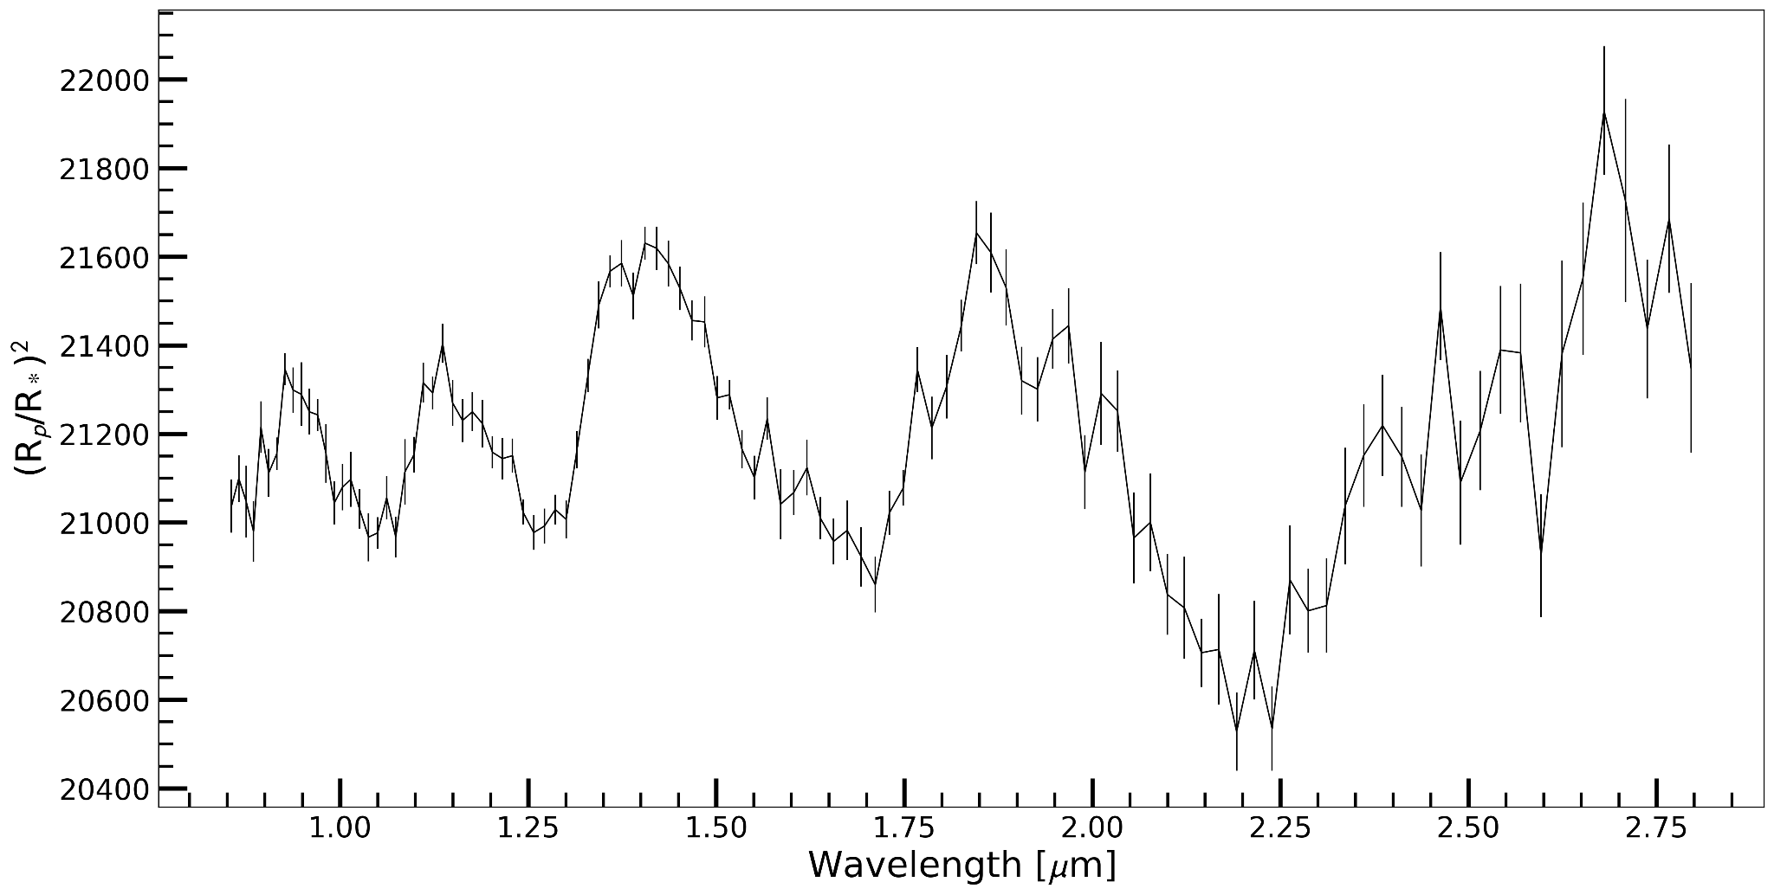
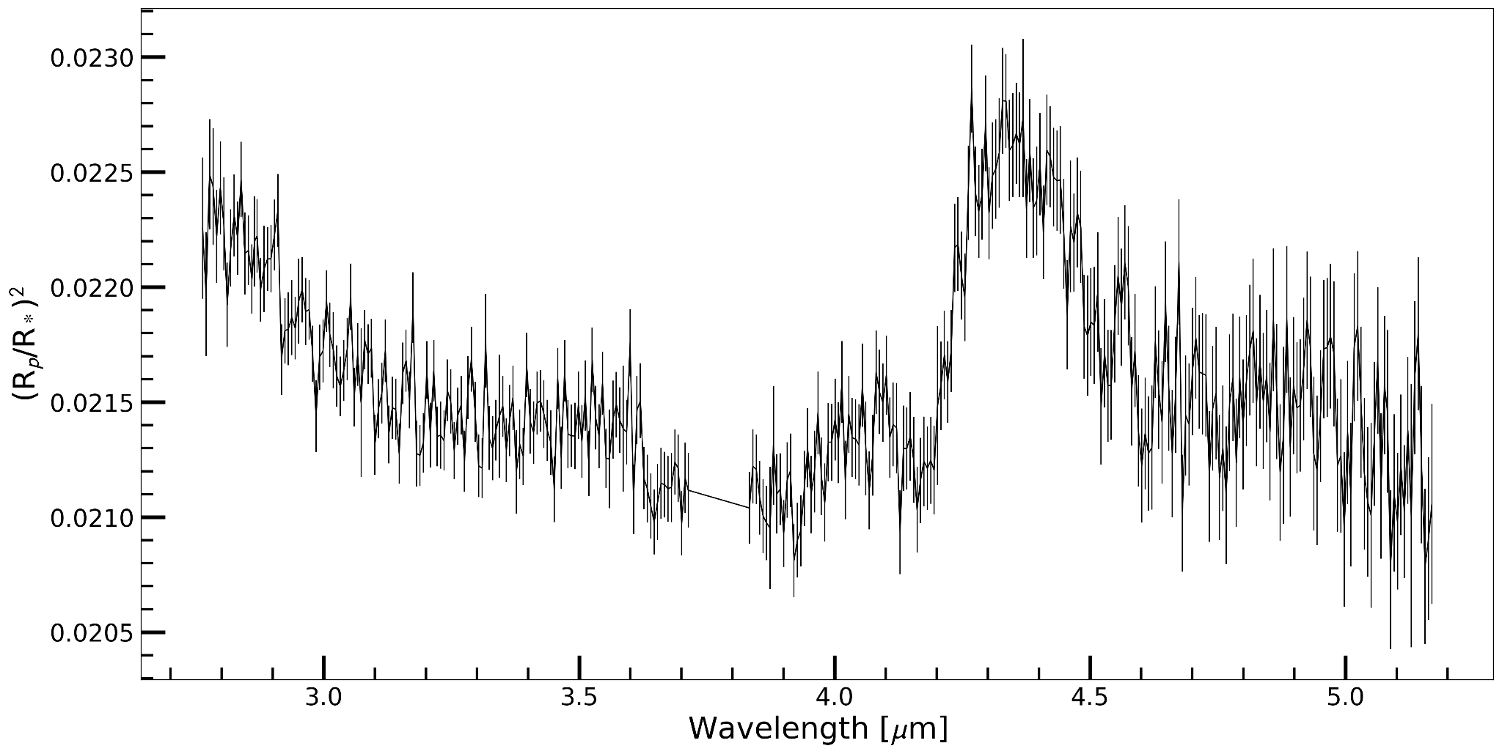
Transmission Spectra
NIRISS SOSS
NIRSpec G385H

Slide 4
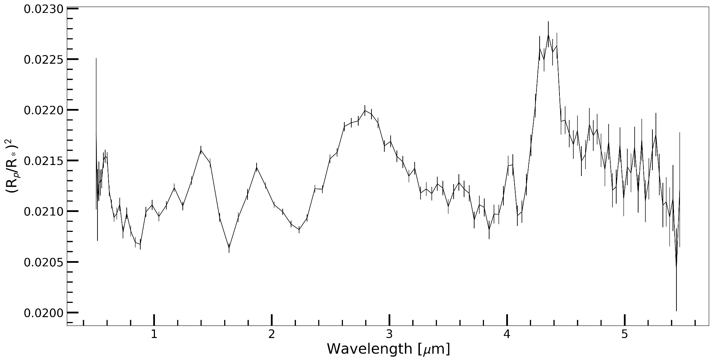
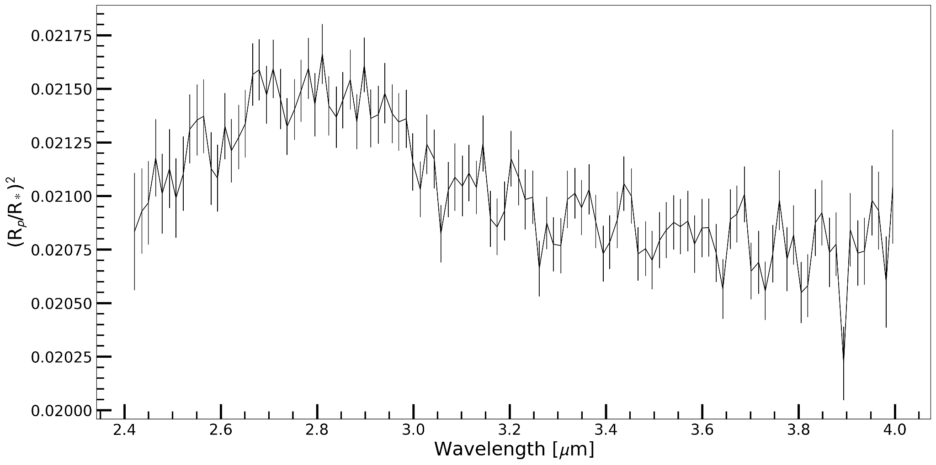
Transmission Spectra
NIRISpec Prism
NIRCam f322w2

Slide 5
Param-Grid
CLOUD-FREE
T_int = 100 K, 200 K, 300 K
Heat_redis = 0.4, 0.5
M/H = 0.1, 0.316, 1.0, 3.162, 10.0, 31.623, 50.119, 100.0
C/O = 0.229, 0.458, 0.687, 0.916
Total no. of models = 192
CLOUDY
T_int = 100 K, 200 K, 300 K
Heat_redis = 0.4, 0.5
M/H = 0.1, 0.316, 1.0, 3.162, 10.0, 31.623, 50.119, 100.0
C/O = 0.229, 0.458, 0.687, 0.916
log K_{zz} = 5, 7, 9, 11
fsed = 0.6, 1.0, 3.0, 6.0, 10.0
Total no. of models = 3840

Slide 6
Questions to ponder
What are the best fit cloud free parameters for each of the four instruments? Are they similar or different?
Are there cases where different data reductions result in different best fit cloud-free parameters?
Does including clouds affect the best fit model?
How does the best fit cloudy model change for each instrument? Are some instruments more affected by clouds than others?
Are there cases where different data reductions result in different best fit cloudy parameters?
Do any best fit parameters seem meaningfully constrained by the datasets? Are any physical parameters better constrained than others?

Slide 7
Answers!

Slide 8
Q1. What are the best fit cloud free parameters for each of the four instruments? Are they similar or different?
Param Instrument | M/H | C/O | T_int (K) | Heat Redistribution
NIRISS SOSS | 3.162 | 0.229 | 100.0 | 0.5
NIRSpec G395H | 100.0 | 0.229 | 100.0 | 0.5
NIRSpec Prism | 100.0 | 0.687 | 200.0 | 0.5
NIRCam f322w2 | 100.0 | 0.687 | 200.0 | 0.4

Slide 9
Q2. Are there cases where different data reductions result in different best fit cloud-free parameters?
Datasets Param | NIRCam f322w2 Hansolo | NIRCam f322w2 Eureka!
M/H | 100.0 | 100.0
C/O | 0.687 | 0.229
T_int (K) | 200.0 | 100.0
Heat Redistribution | 0.4 | 0.5

Slide 10
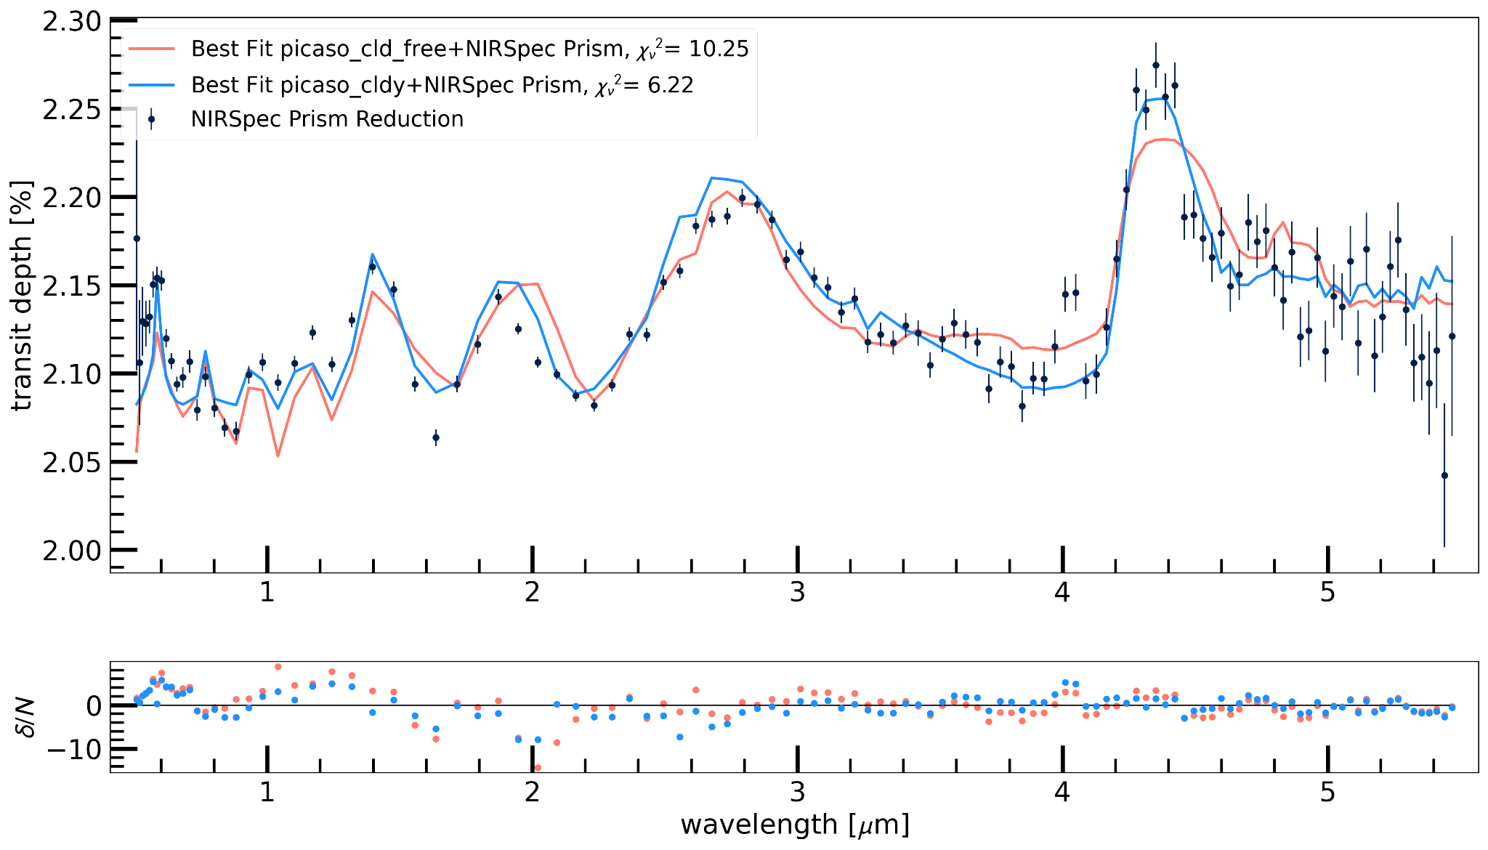
Q3. Does including clouds affect the best fit model?

Slide 11
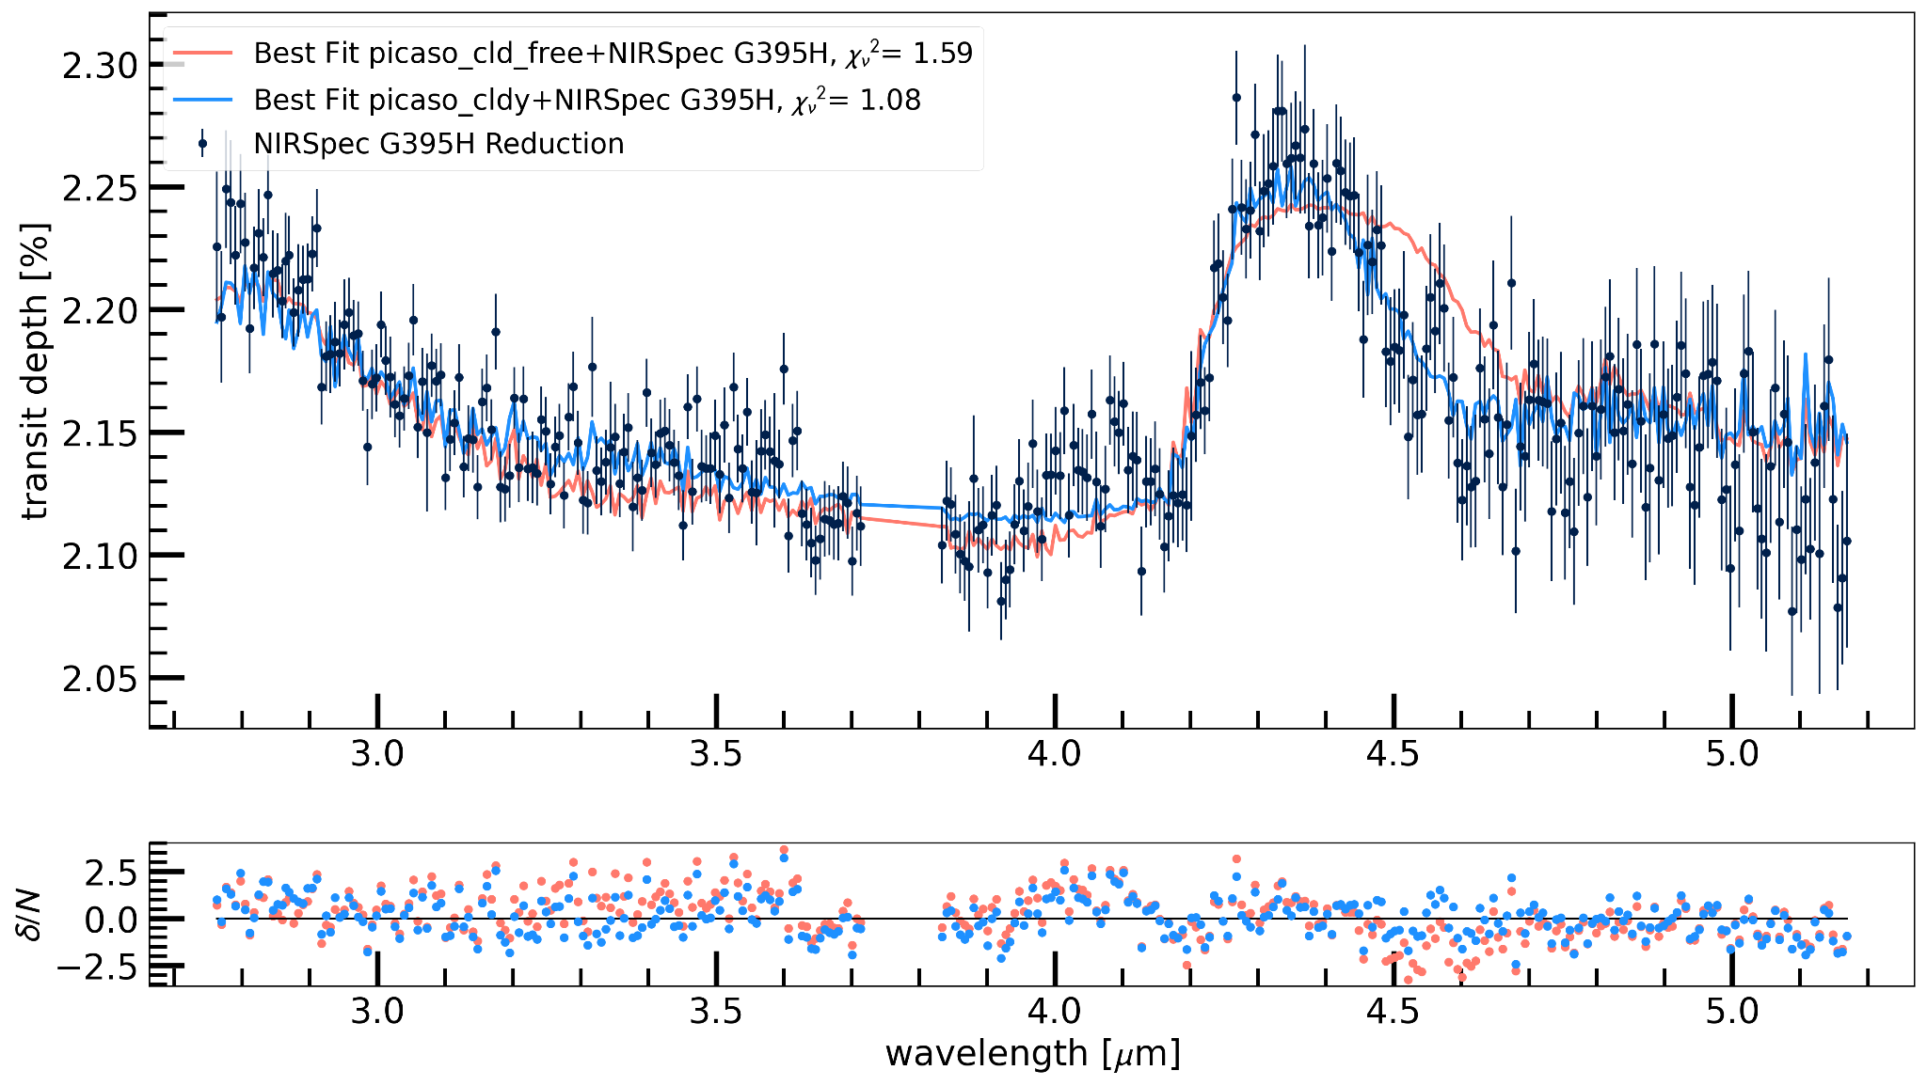
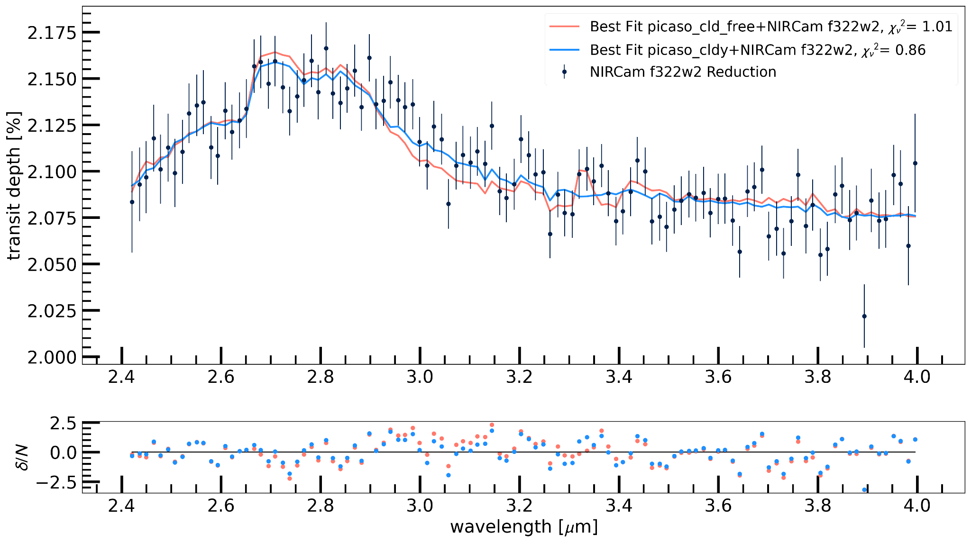
👈 NIRSpec G395H
NIRCam f322w2 👉

Slide 12
Q4. How does the best fit cloudy model change for each instrument? Are some instruments more affected by clouds than others?
Param Instrument | M/H | C/O | T_int (K) | Heat Redistribution | log K_zz
NIRISS SOSS | 3.162 | 0.229 | 100.0 | 0.5 | 11.0
NIRSpec G395H | 3.162 | 0.458 | 100.0 | 0.5 | 9.0
NIRSpec Prism | 3.162 | 0.458 | 300.0 | 0.5 | 9.0
NIRCam f322w2 | 100.0 | 0.229 | 100.0 | 0.4 | 11.0

Slide 13
Q5. Are there cases where different data reductions result in different best fit cloudy parameters?
Dataset Param | NIRCam f322w2 Hansolo | NIRCam f322w2 Eureka!
M/H | 100.0 | 1.0
C/O | 0.229 | 0.229
T_int (K) | 100.0 | 100.0
Heat Redistribution | 0.4 | 0.5
log K_zz | 11.0 | 9.0

Slide 14
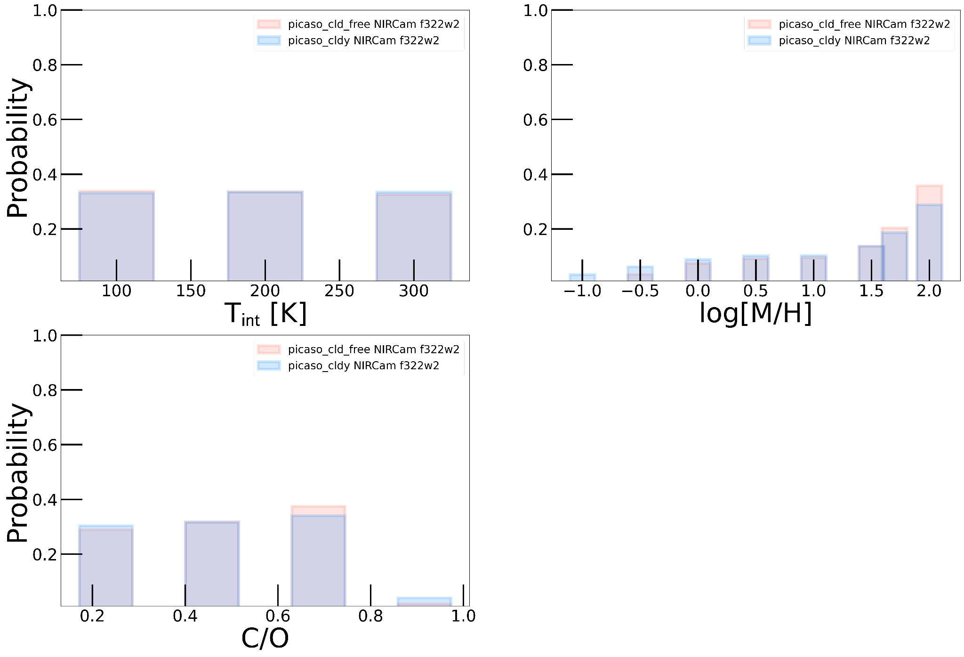
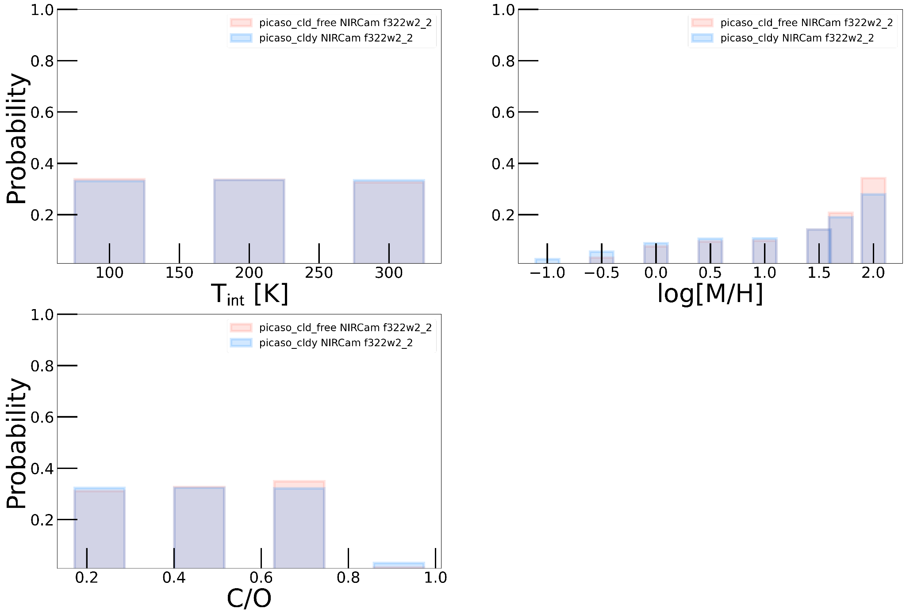
Q6. Do any best fit parameters seem meaningfully constrained by the datasets? Are any physical parameters better constrained than others?
NIRCam f322w2 (Hansolo)
NIRCam f322w2 (Eureka)

Slide 15
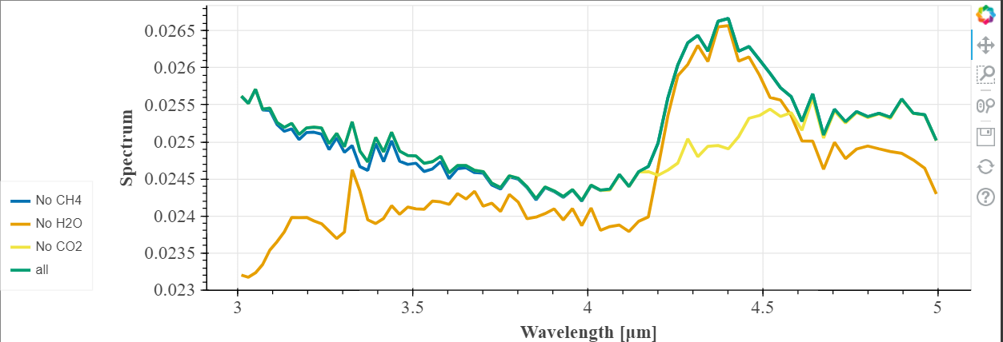
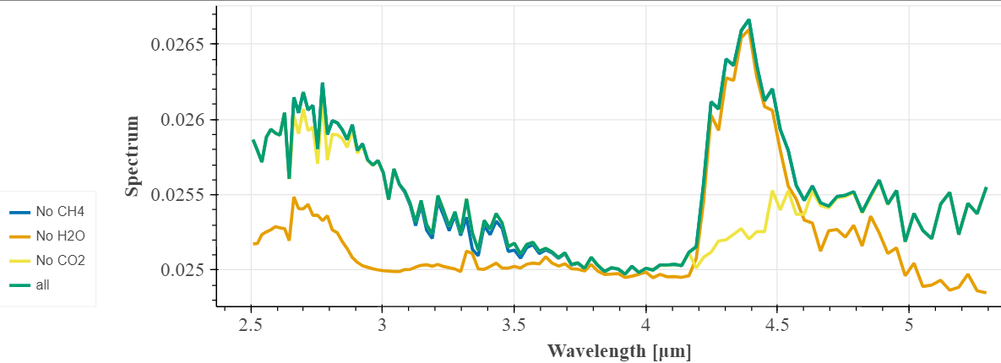
Contribution From Each Molecule
NIRISS SOSS
NIRSpec G385H

Slide 16
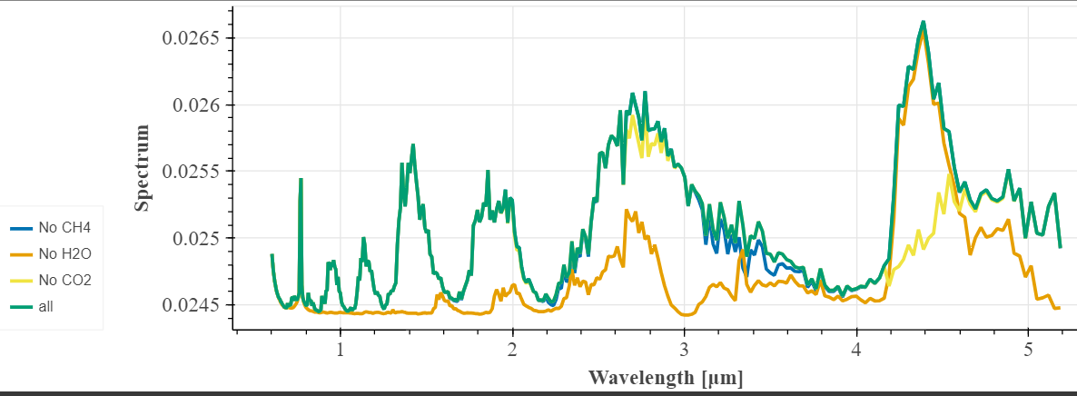
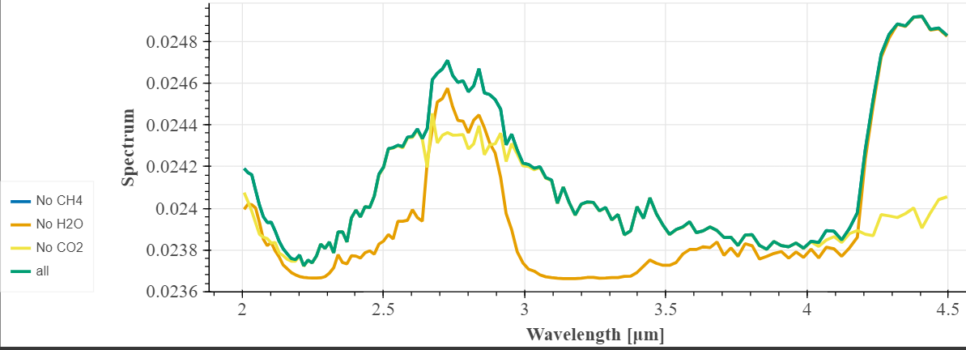
Contribution From Each Molecule
NIRISpec Prism
NIRCam f322w2

Slide 17

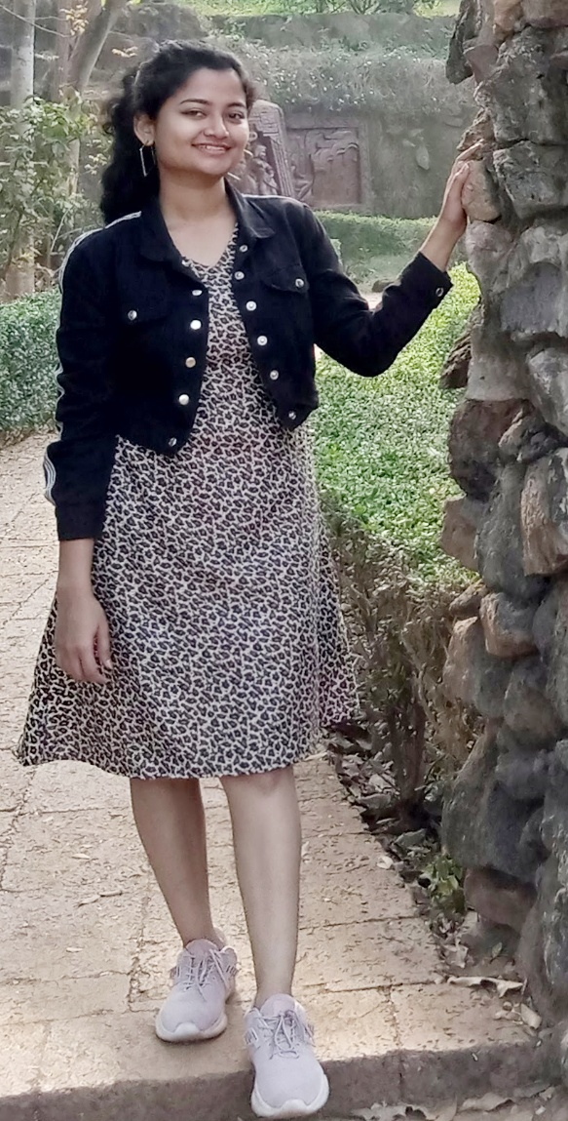


Our team
Avijeet
Palit
Dibya Bharati Pradhan
Jeetendra Joshi
Rajesh Mudaliyar
MSc (Physics), T.N.B College, BS (Data Science and AI), IIT Madras , India
5th year Int. MSc (Physics), NISER, Bhubaneswar, India
Assistant Professor of Physics, Bhavan’s College, Mumbai, India

Slide 18
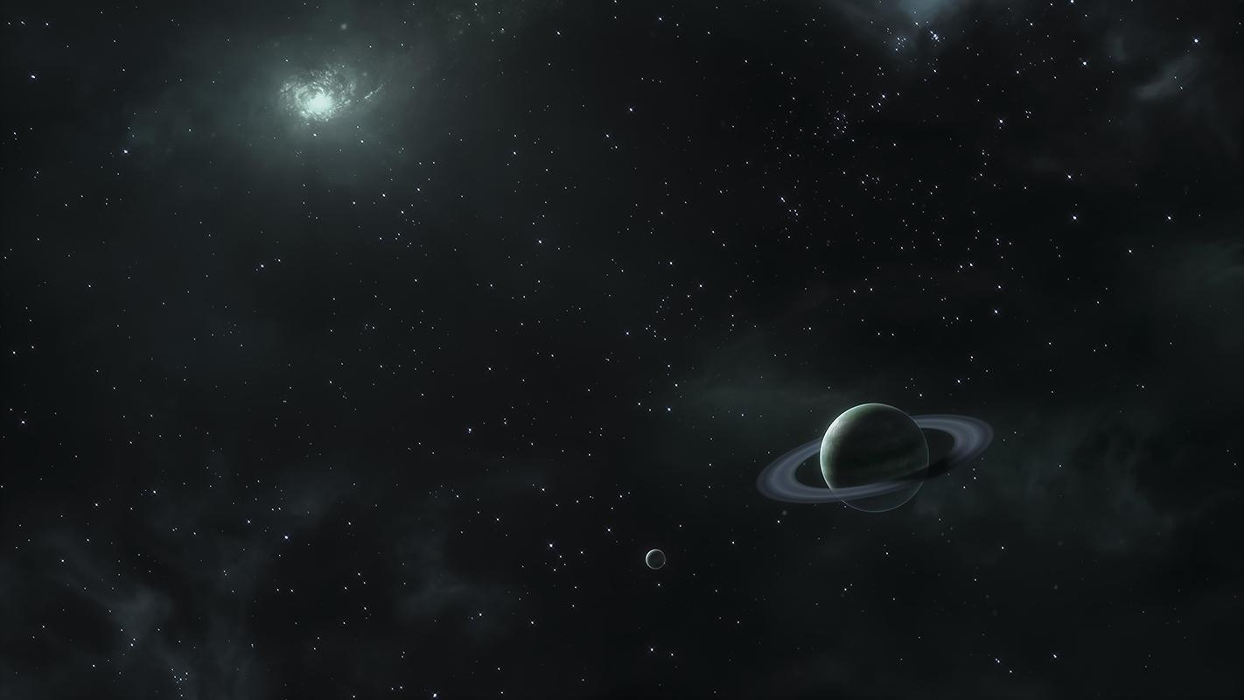
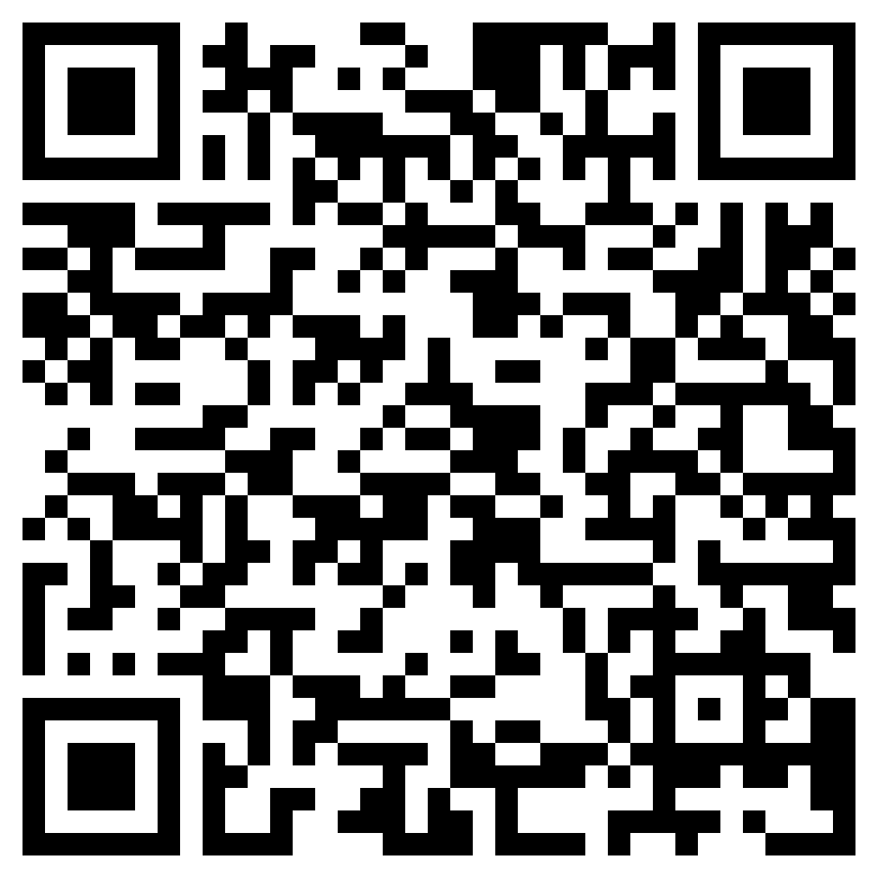
View our Collab here 👇
Secrets unveiled afar, exoplanets beckon exploration's call.
Thank You!

